Slide 1


Azərbaycan Dövlət Neft və Sənaye Universiteti
Calculus
Single Variable

Slide 2
Basic Differentiation Rules and Rates of Change

Slide 3
Outline
In this lecture you will be introduced to several differentiation rules that allow you to find derivatives without the direct use of the limit definition.

Slide 4
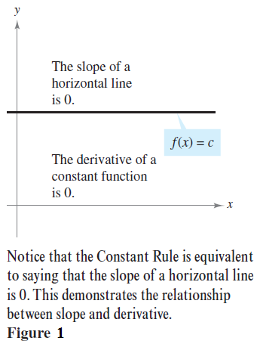
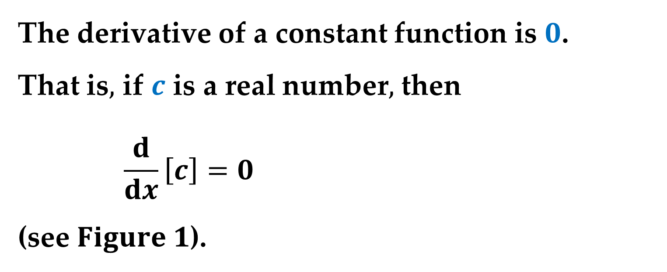
The Constant Rule
The derivative of a constant function is $0$.
That is$,$ if $c$ is a real number$,$ then
$$\frac{d}{dx}\left[c\right]=0$$
(see $Figure 1$).

Slide 5
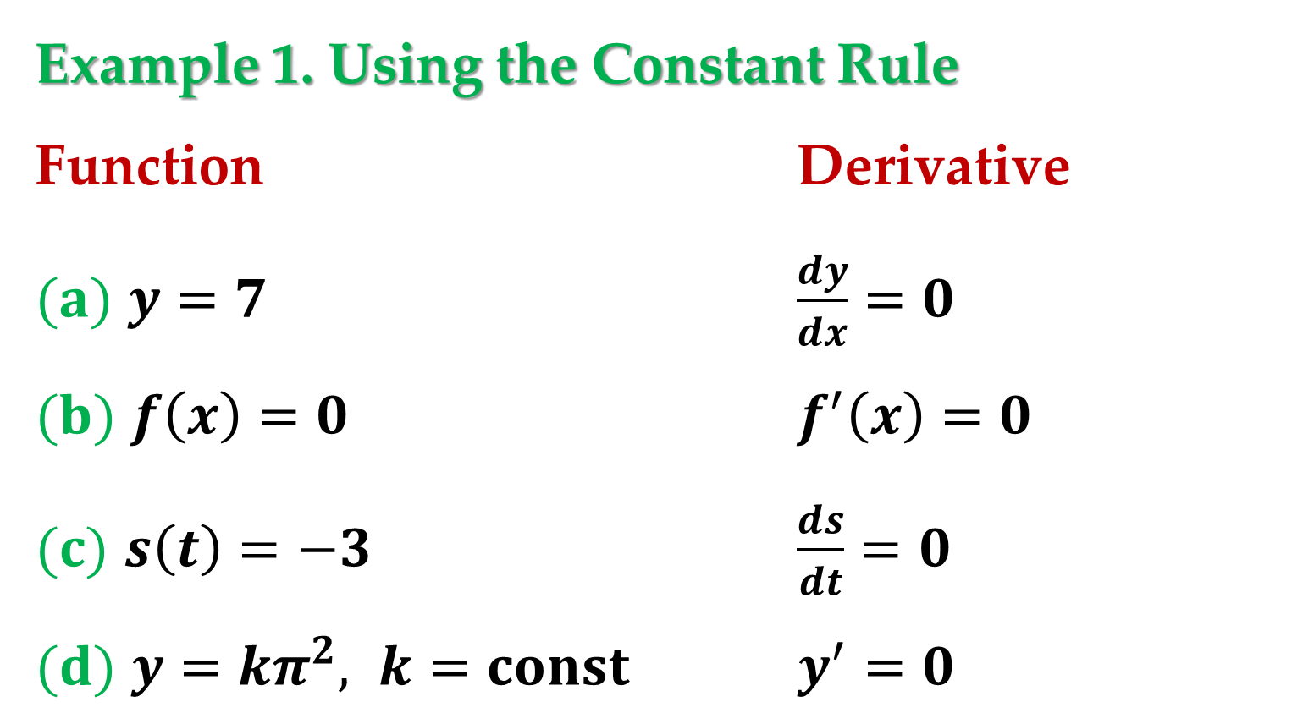
Example 1. Using the Constant Rule
Function Derivative
$(a)$ $y=7$ $\frac{dy}{dx}=0$
$(b)$ $f\left(x\right)=0$ $f^{′}\left(x\right)=0$
$(c)$ $s\left(t\right)=−3$ $\frac{ds}{dt}=0$
$(d)$ $y=kπ^{2}, k=const$ $y^{′}=0$

Slide 6
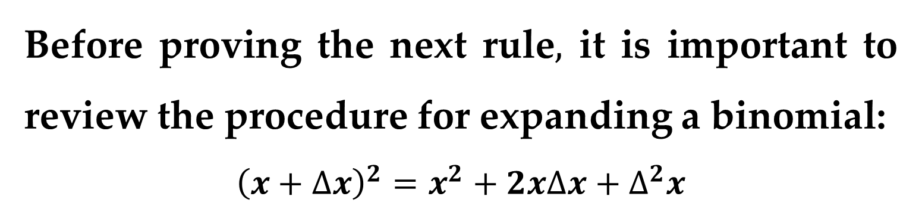
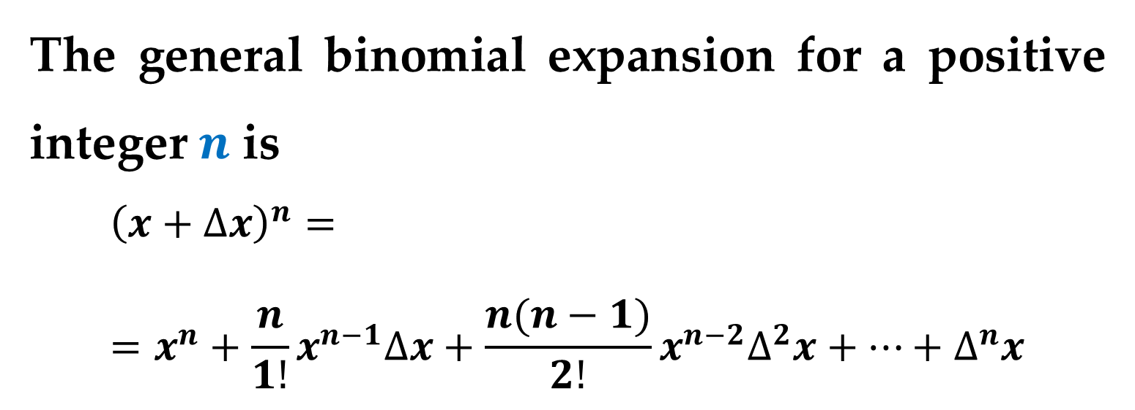
The Power Rule
Before proving the next rule$,$ it is important to review the procedure for expanding a binomial:
$${\left(x+∆x\right)}^{2}=x^{2}+2x∆x+∆^{2}x$$
$${\left(x+∆x\right)}^{3}=x^{3}+3x^{2}∆x+3x∆^{2}x+∆^{3}x$$
The general binomial expansion for a positive integer $n$ is
$${\left(x+∆x\right)}^{n}==x^{n}+\frac{n}{1!}x^{n−1}∆x+\frac{n(n−1)}{2!}x^{n−2}∆^{2}x+…+∆^{n}x$$

Slide 7
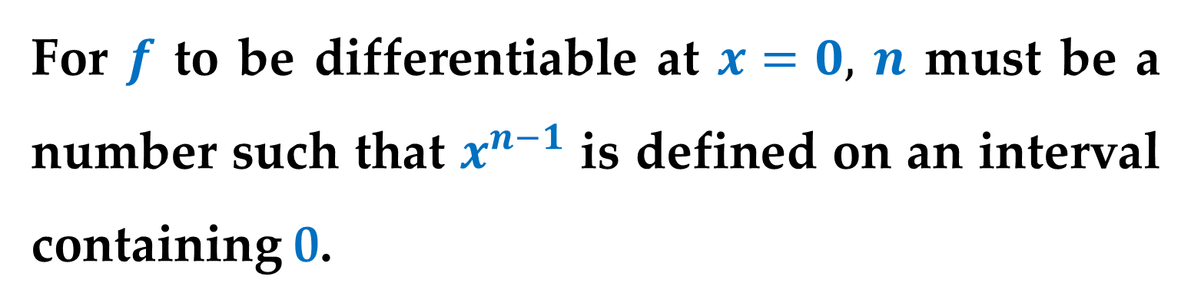
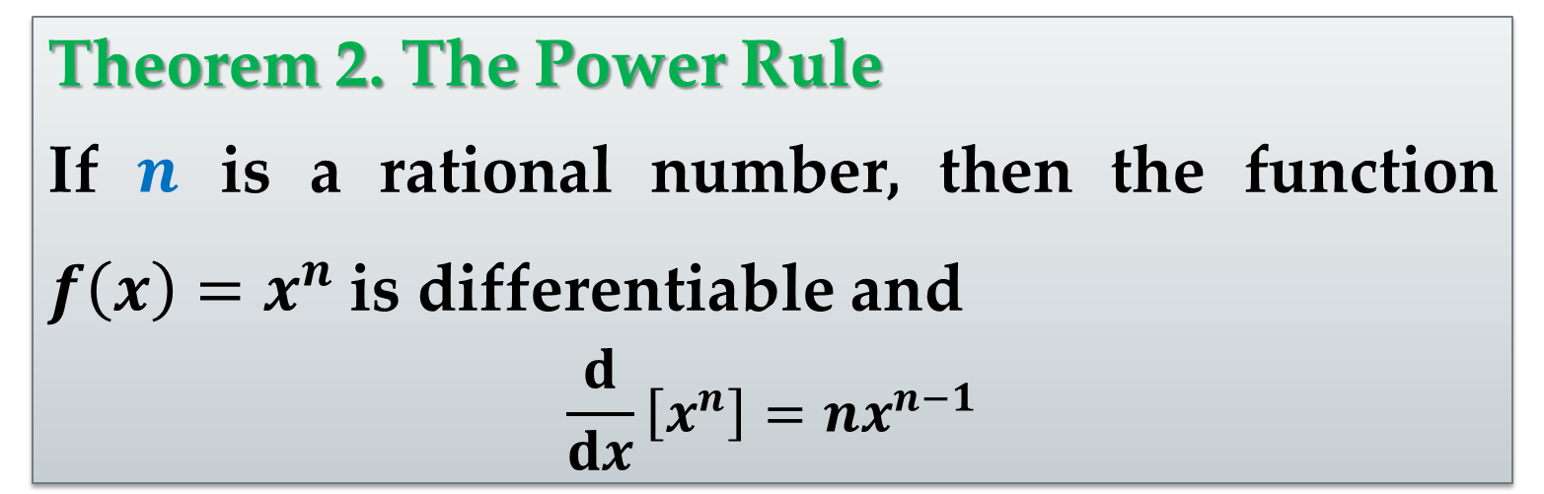
This binomial expansion is used in proving a special case of the Power Rule.
Theorem 2. The Power Rule
If $n$ is a rational number, then the function $f\left(x\right)=x^{n}$is differentiable and
$$\frac{d}{dx}\left[x^{n}\right]=nx^{n−1}$$
For $f$ to be differentiable at $x=0,$ $n$ must be a number such that $x^{n−1}$ is defined on an interval containing 0.

Slide 8
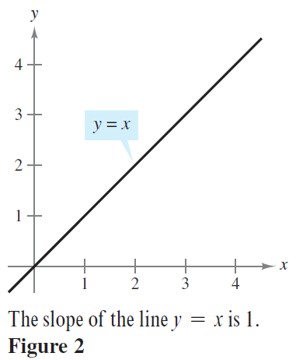
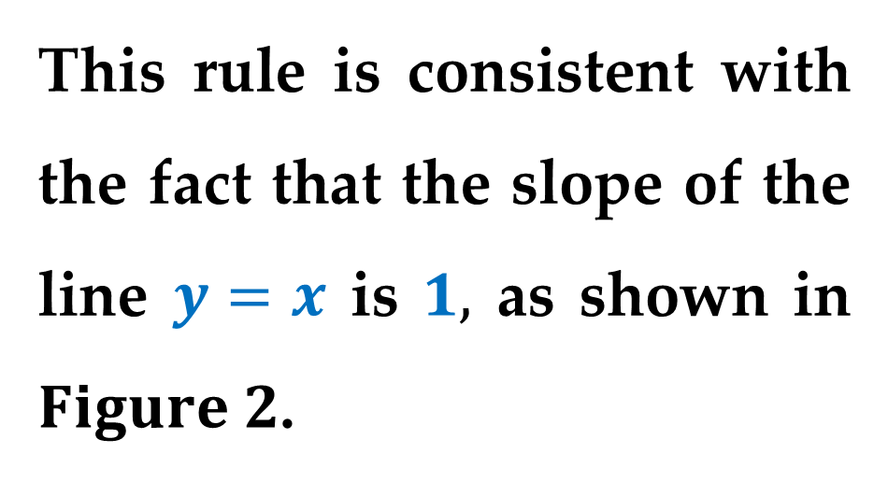
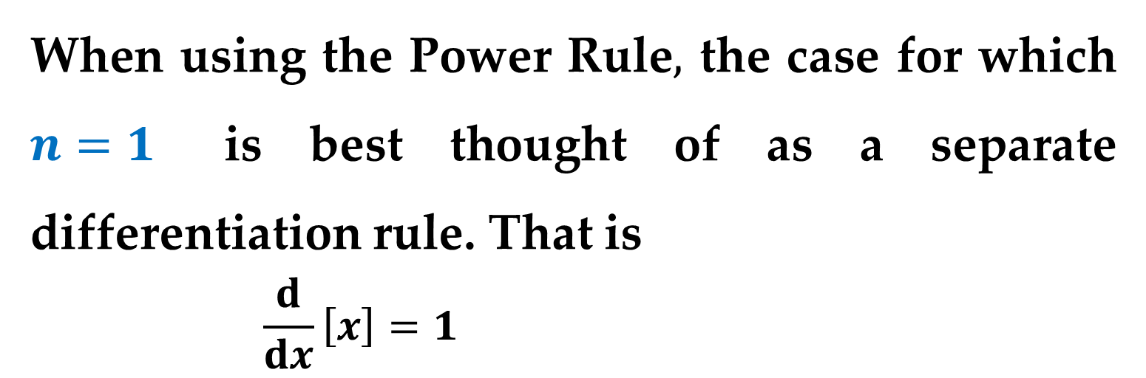
Remark
When using the Power Rule$,$ the case for which $n=1$ is best thought of as a separate differentiation rule. That is
$$\frac{d}{dx}\left[x\right]=1$$
This rule is consistent with the fact that the slope of the line $y=x$ is $1,$ as shown in $Figure 2$.

Slide 9
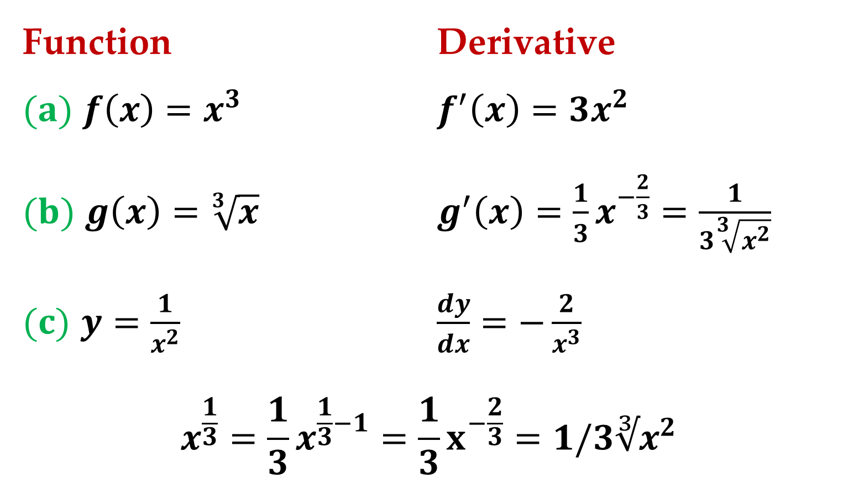
Example 2. Using the Power Rule
Function Derivative
$(a)$ $f\left(x\right)=x^{3}$ $f^{′}\left(x\right)=3x^{2}$
$(b)$ $g\left(x\right)=\sqrt[3]{x}$ $g^{′}\left(x\right)=\frac{1}{3}x^{−\frac{2}{3}}=\frac{1}{3\sqrt[3]{x^{2}}}$
$(c)$ $y=\frac{1}{x^{2}}$ $\frac{dy}{dx}=−\frac{2}{x^{3}}$
$$x^{\frac{1}{3}}=\frac{1}{3}x^{\frac{1}{3}−1}=\frac{1}{3}x^{−\frac{2}{3}}=1/3∛x^{2}$$

Slide 10
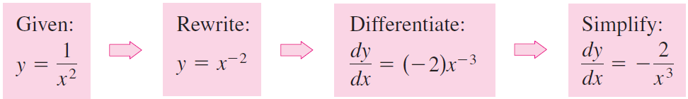
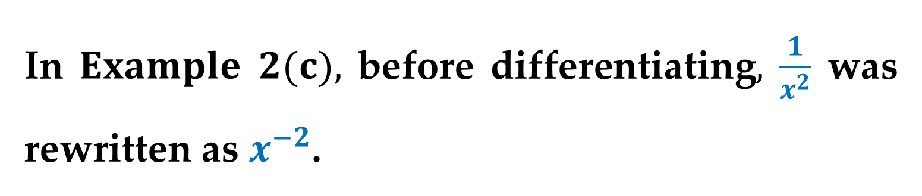
In $Example 2(c),$ before differentiating$,$ $\frac{1}{x^{2}}$ was rewritten as $x^{−2}$.
Rewriting is the first step in many differentiation problems.

Slide 11
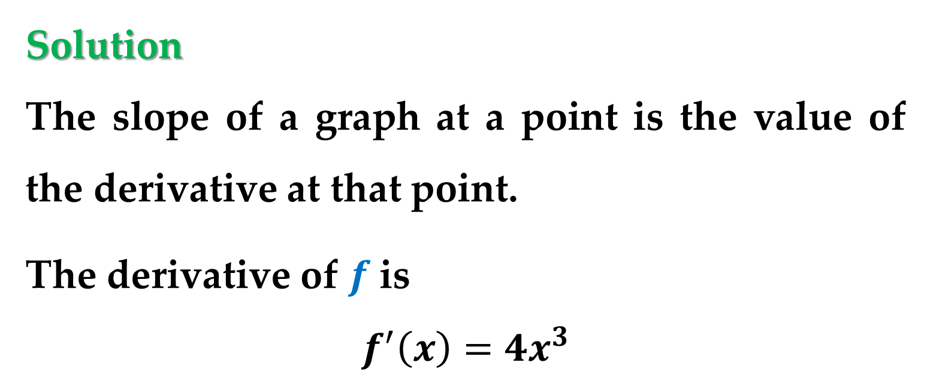
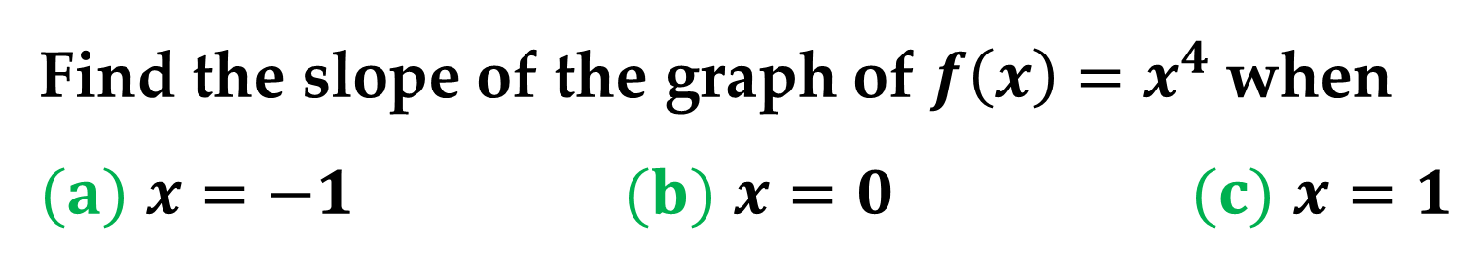
Example 3. Finding the Slope of a Graph
Find the slope of the graph of $f\left(x\right)=x^{4}$when
$(a)$ $x=−1$ $(b)$ $x=0$ $(c)$ $x=1$
Solution
The slope of a graph at a point is the value of the derivative at that point.
The derivative of $f$is
$$f^{′}\left(x\right)=4x^{3}$$

Slide 12
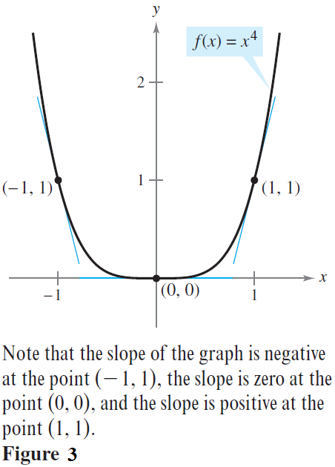
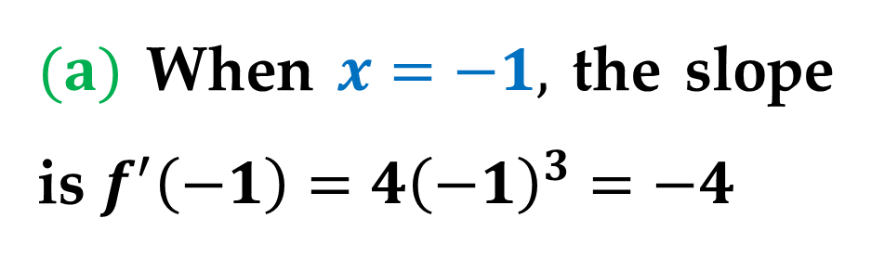
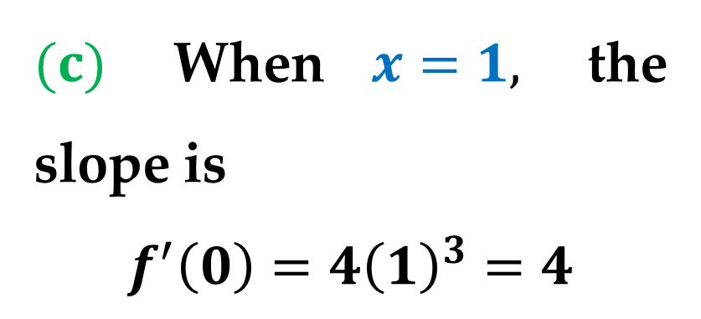
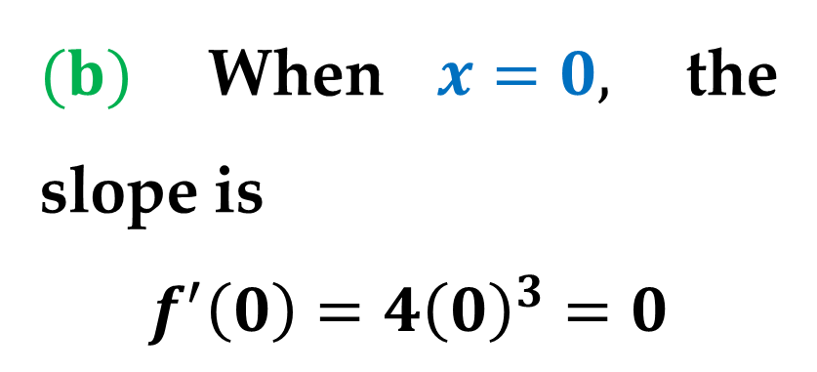
Solution (continued)
$(a)$ When $x=−1,$ the slope is $f^{′}\left(−1\right)=4{\left(−1\right)}^{3}=−4$
$(b)$ When $x=0,$ the slope is
$$f^{′}\left(0\right)=4{\left(0\right)}^{3}=0$$
$(c)$ When $x=1,$ the slope is
$$f^{′}\left(0\right)=4{\left(1\right)}^{3}=4$$

Slide 13
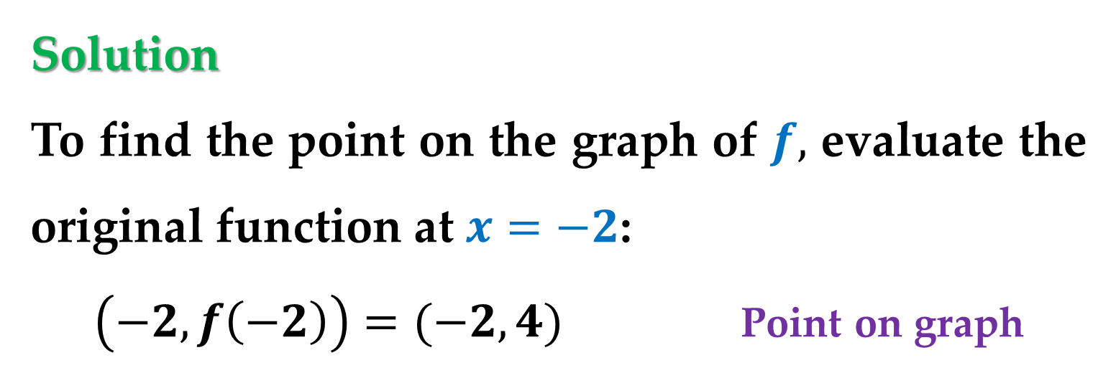
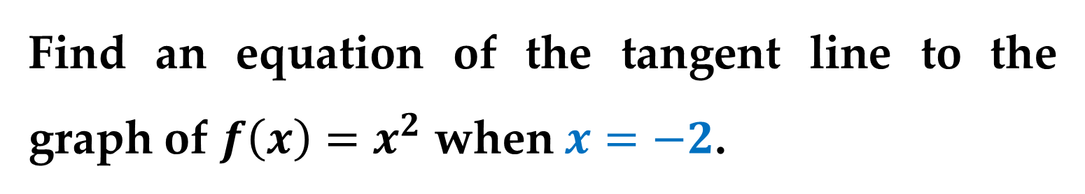
Example 4. Finding an Equation of a Tangent
Line
Find an equation of the tangent line to the graph of $f\left(x\right)=x^{2}$ when $x=−2$.
Solution
To find the point on the graph of $f,$ evaluate the original function at $x=−2$:
$\left(−2,f\left(−2\right)\right)=(−2,4)$ Point on graph

Slide 14
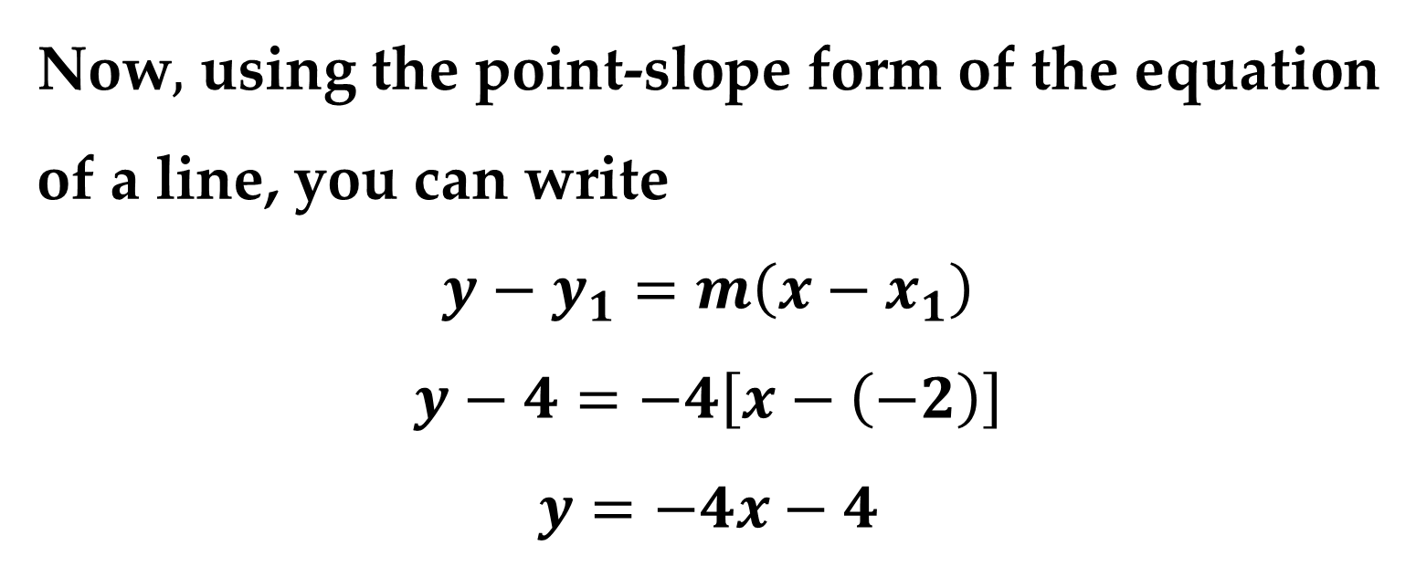
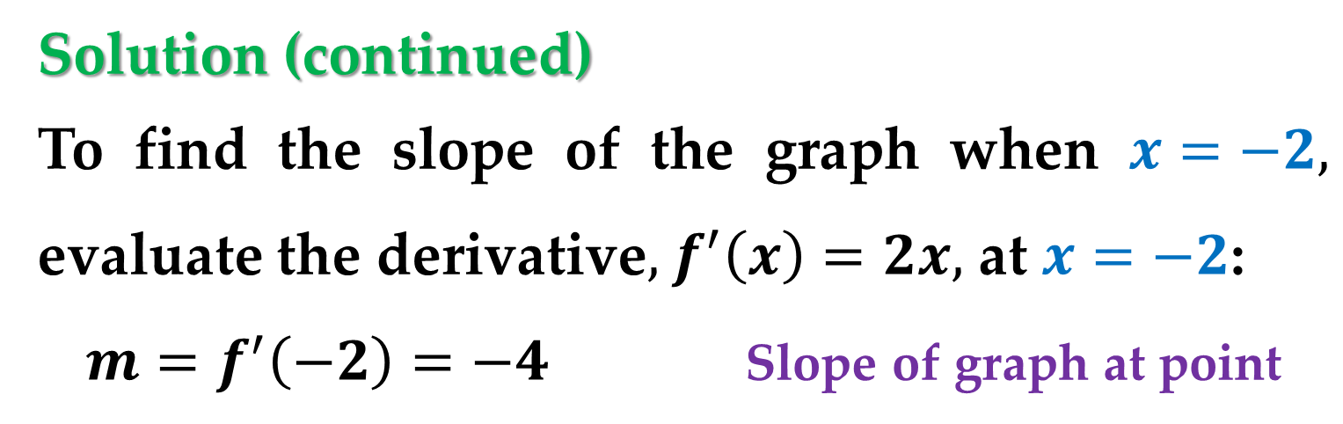
Solution (continued)
To find the slope of the graph when $x=−2,$ evaluate the derivative$,$ $f^{′}\left(x\right)=2x,$ at $x=−2$:
$m=f^{′}\left(−2\right)=−4$ Slope of graph at point
Now$,$ using the point-slope form of the equation of a line, you can write
$$y−y_{1}=m\left(x−x_{1}\right)$$
$$y−4=−4\left[x−\left(−2\right)\right]$$
$$y=−4x−4$$

Slide 15
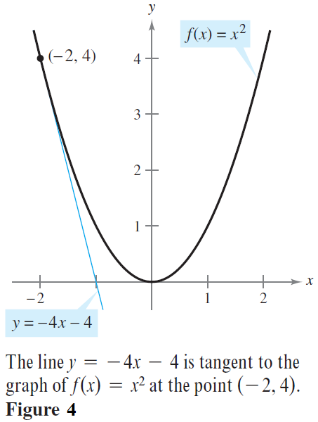
Solution (continued)

Slide 16
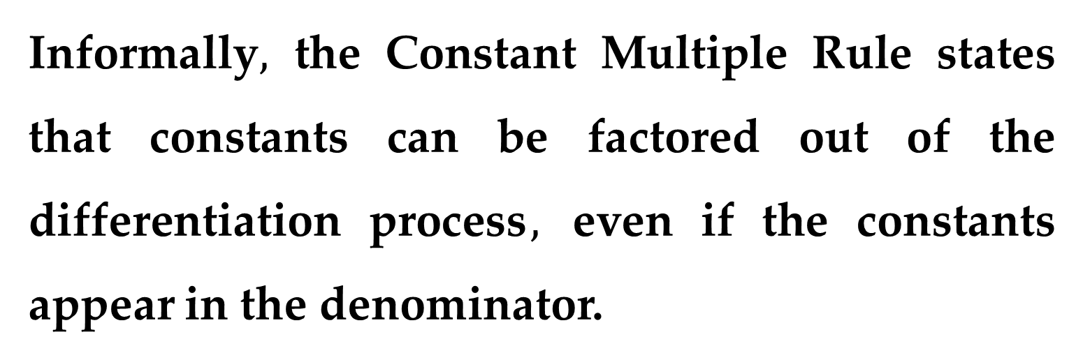
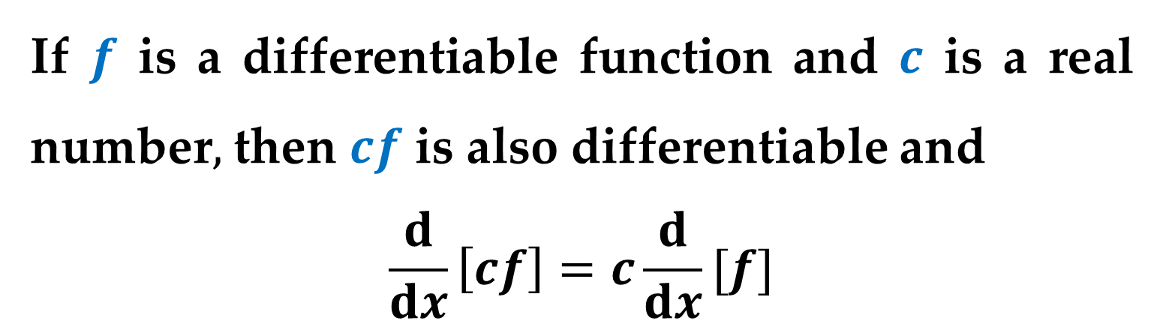
The Constant Multiple Rule
If $f$ is a differentiable function and $c$ is a real number$,$ then $cf$ is also differentiable and
$$\frac{d}{dx}\left[cf\right]=c\frac{d}{dx}[f]$$
Informally$,$ the Constant Multiple Rule states that constants can be factored out of the differentiation process$,$ even if the constants appear in the denominator.

Slide 17
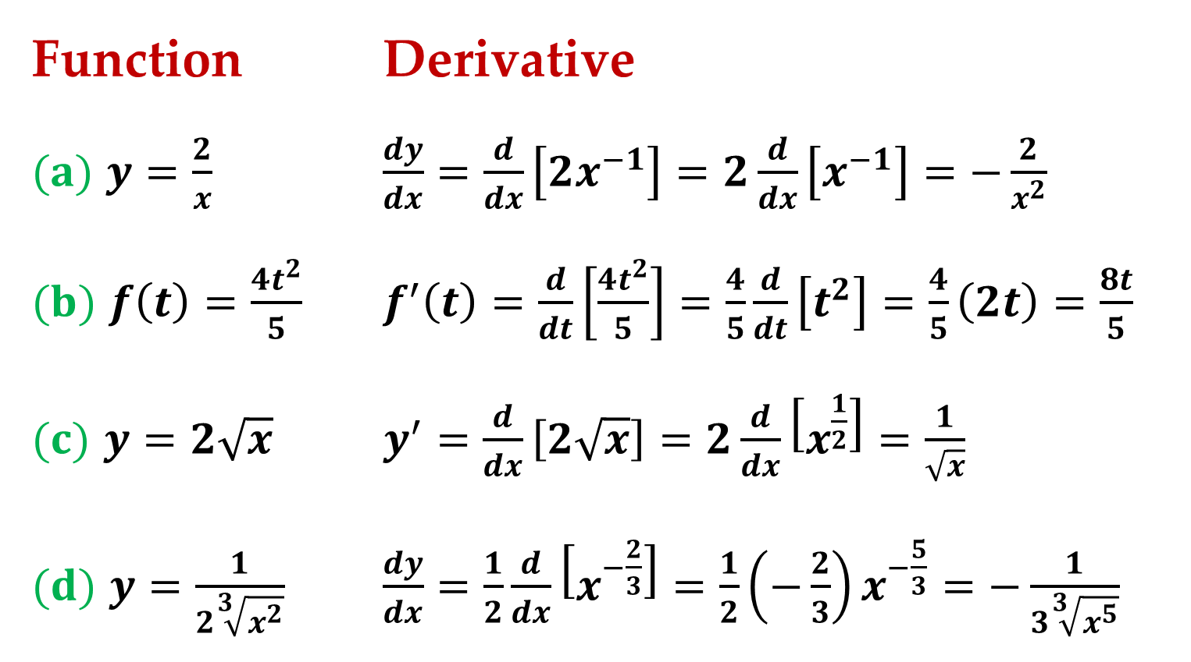
Example 5. Using the Constant Multiple Rule
Function Derivative
$(a)$ $y=\frac{2}{x}$ $\frac{dy}{dx}=\frac{d}{dx}\left[2x^{−1}\right]=2\frac{d}{dx}\left[x^{−1}\right]=−\frac{2}{x^{2}}$
$(b)$ $f\left(t\right)=\frac{4t^{2}}{5}$ $f^{′}\left(t\right)=\frac{d}{dt}\left[\frac{4t^{2}}{5}\right]=\frac{4}{5}\frac{d}{dt}\left[t^{2}\right]=\frac{4}{5}\left(2t\right)=\frac{8t}{5}$
$(c)$ $y=2\sqrt{x}$ $y^{′}=\frac{d}{dx}\left[2\sqrt{x}\right]=2\frac{d}{dx}\left[x^{\frac{1}{2}}\right]=\frac{1}{\sqrt{x}}$
$(d)$ $y=\frac{1}{2\sqrt[3]{x^{2}}}$ $\frac{dy}{dx}=\frac{1}{2}\frac{d}{dx}\left[x^{−\frac{2}{3}}\right]=\frac{1}{2}\left(−\frac{2}{3}\right)x^{−\frac{5}{3}}=−\frac{1}{3\sqrt[3]{x^{5}}}$

Slide 18
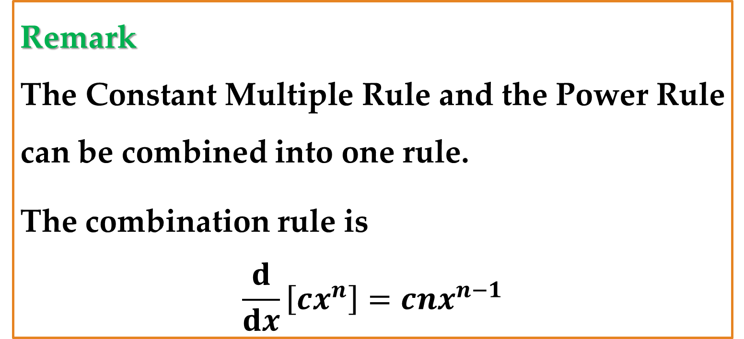
Remark
The Constant Multiple Rule and the Power Rule can be combined into one rule.
The combination rule is
$$\frac{d}{dx}\left[cx^{n}\right]=cnx^{n−1}$$

Slide 19
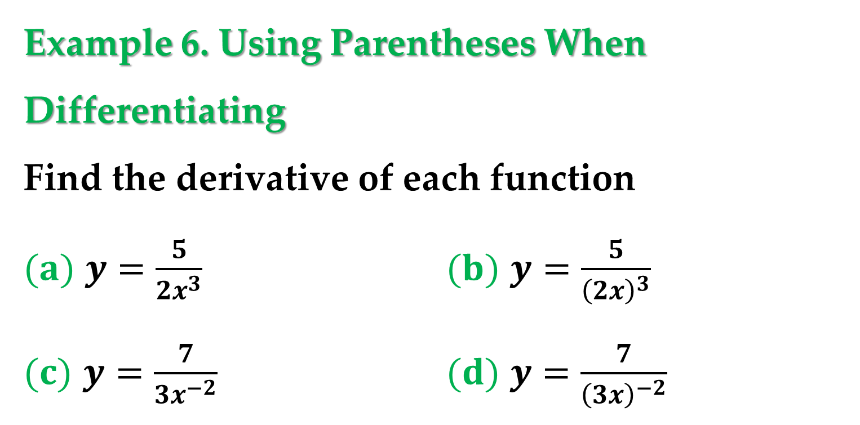
Example 6. Using Parentheses When Differentiating
Find the derivative of each function
$(a)$ $y=\frac{5}{2x^{3}}$ $(b)$ $y=\frac{5}{{\left(2x\right)}^{3}}$
$(c)$ $y=\frac{7}{3x^{−2}}$ $(d)$ $y=\frac{7}{{\left(3x\right)}^{−2}}$

Slide 20
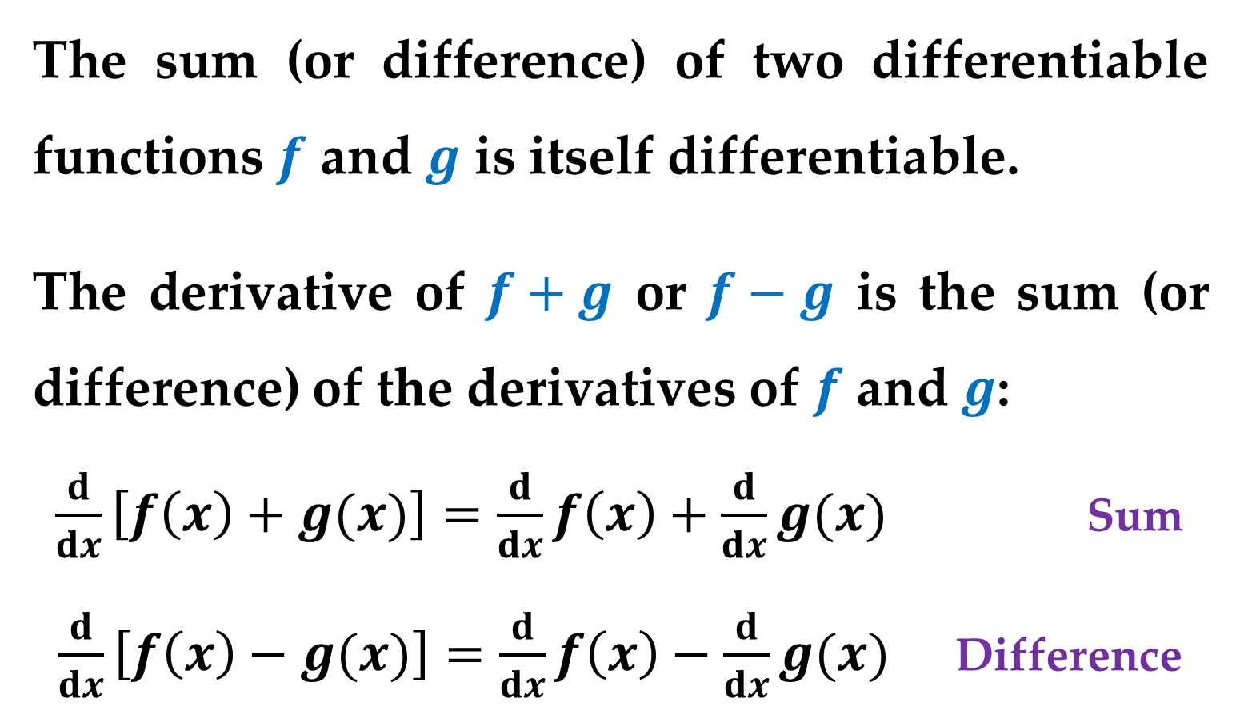
The Sum and Difference Rule
The sum (or difference) of two differentiable functions $f$ and $g$ is itself differentiable.
The derivative of $f+g$ or $f−g$ is the sum (or difference) of the derivatives of $f$ and $g$:
$\frac{d}{dx}\left[f\left(x\right)+g(x)\right]=\frac{d}{dx}f\left(x\right)+\frac{d}{dx}g(x)$ Sum
$\frac{d}{dx}\left[f\left(x\right)−g(x)\right]=\frac{d}{dx}f\left(x\right)−\frac{d}{dx}g(x)$ Difference

Slide 21
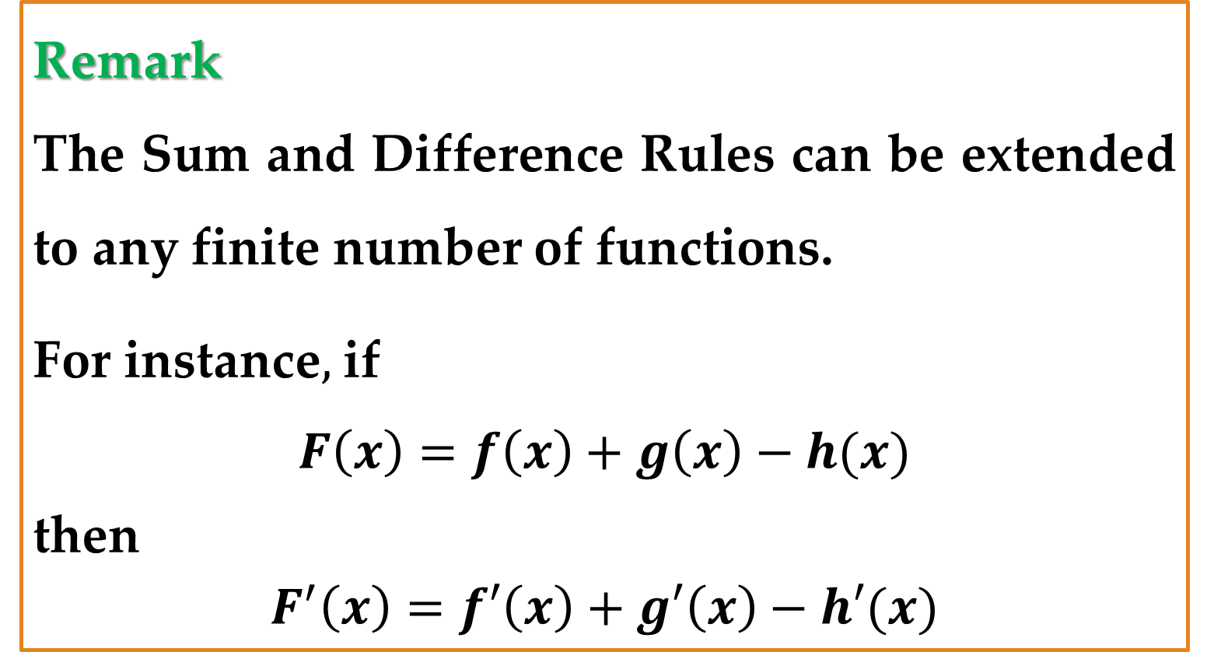
Remark
The Sum and Difference Rules can be extended to any finite number of functions.
For instance$,$ if
$$F\left(x\right)=f\left(x\right)+g\left(x\right)−h(x)$$
then
$$F^{′}\left(x\right)=f′\left(x\right)+g′\left(x\right)−h′(x)$$

Slide 22
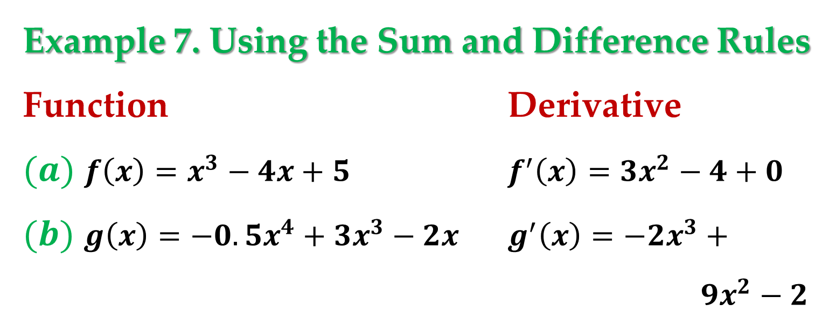
Example 7. Using the Sum and Difference Rules
Function Derivative
$(a)$ $f\left(x\right)=x^{3}−4x+5$ $f^{′}\left(x\right)=3x^{2}−4+0$
$(b)$ $g\left(x\right)=−0.5x^{4}+3x^{3}−2x$ $g^{′}\left(x\right)=−2x^{3}+$
$9x^{2}−2$

Slide 23

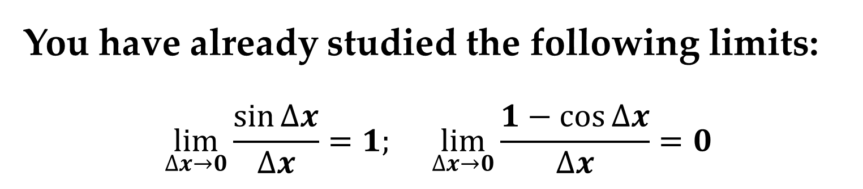
Derivatives of Trigonometric Functions
You have already studied the following limits:
$$\lim_{∆x→0}{\frac{\sin{∆x}}{∆x}}=1; \lim_{∆x→0}{\frac{1−\cos{∆x}}{∆x}}=0$$
These two limits can be used to prove differentiation rules for the sine and cosine functions.
$$\frac{d}{dx}\left[\sin{x}\right]=\cos{x}; \frac{d}{dx}\left[\cos{x}\right]=−sin{x}$$

Slide 24
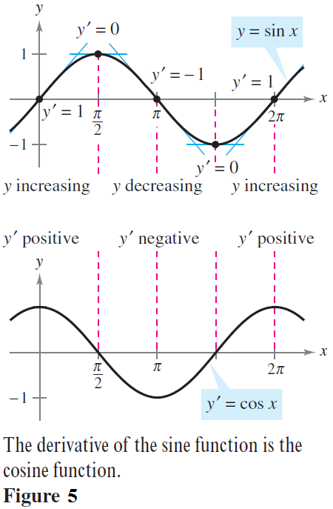
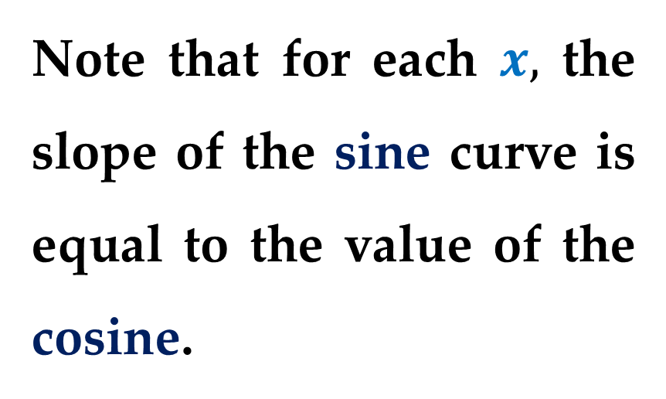
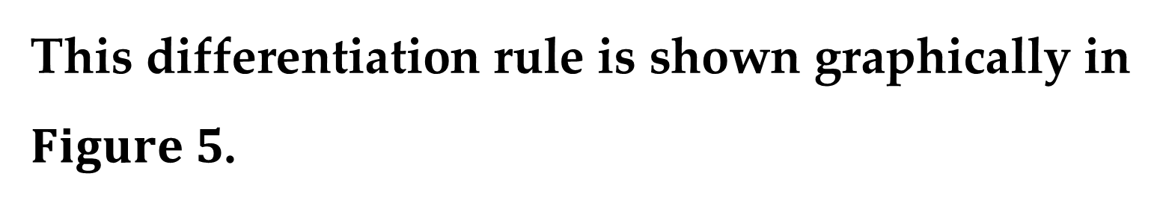
This differentiation rule is shown graphically in $Figure 5$.
Note that for each $x,$ the slope of the sine curve is equal to the value of the cosine.

Slide 25
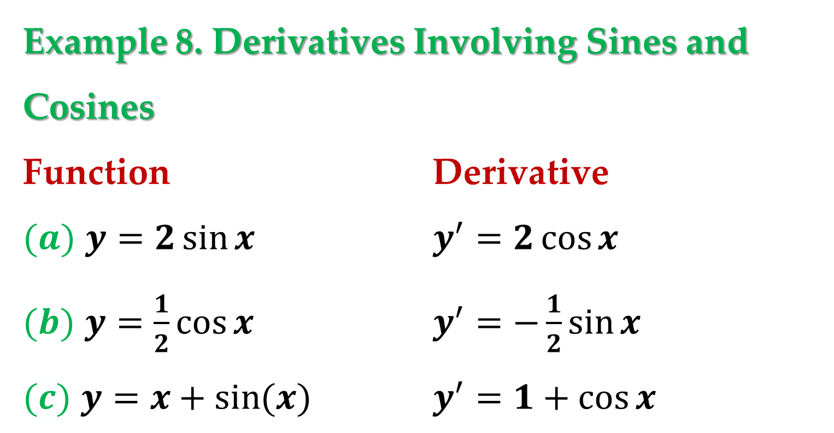
Example 8. Derivatives Involving Sines and Cosines
Function Derivative
$(a)$ $y=2\sin{x}$ $y^{′}=2\cos{x}$
$(b)$ $y=\frac{1}{2}\cos{x}$ $y^{′}=−\frac{1}{2}\sin{x}$
$(c)$ $y=x+\sin{(x)}$ $y^{′}=1+\cos{x}$

Slide 26
Rates of Change
You have seen how the derivative is used to determine slope.
The derivative can also be used to determine the rate of change of one variable with respect to another.
Applications involving rates of change occur in a wide variety of fields.

Slide 27
A few examples are
population growth rates
production rates
water flow rates
velocity
acceleration.
A common use for rate of change is to describe the motion of an object moving in a straight line.

Slide 28
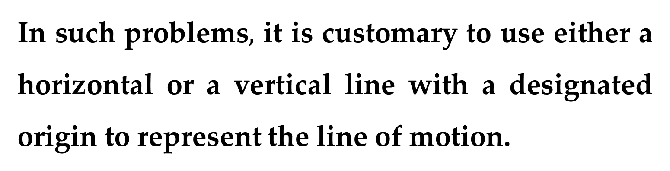
In such problems$,$ it is customary to use either a horizontal or a vertical line with a designated origin to represent the line of motion.
On such lines, movement to the right (or upward) is considered to be in the positive direction;
and movement to the left (or downward) is considered to be in the negative direction.

Slide 29
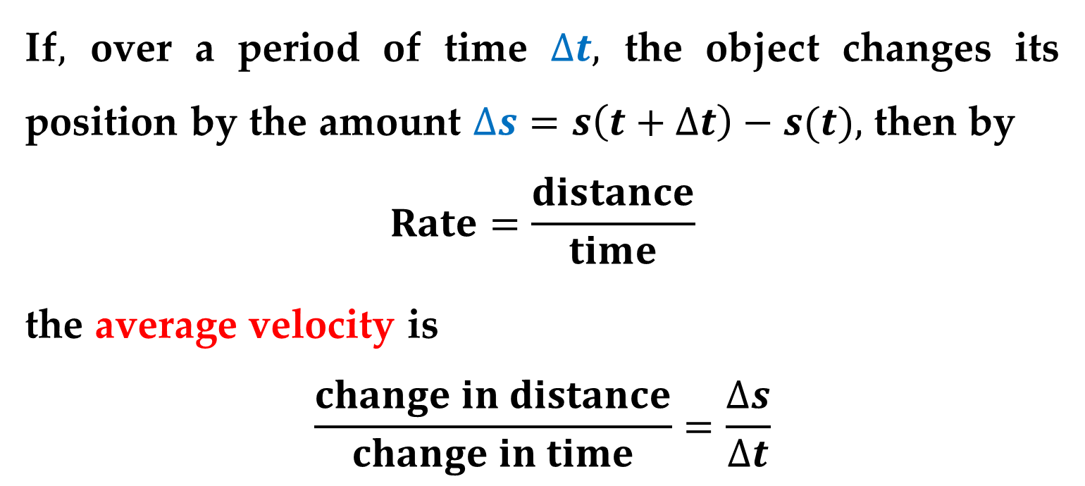
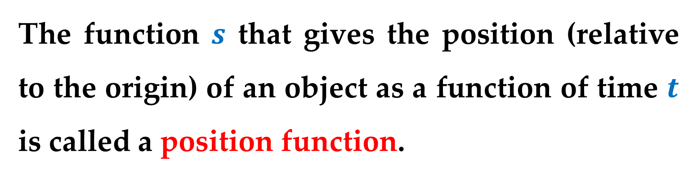
The function $s$ that gives the position (relative to the origin) of an object as a function of time $t$ is called a position function.
If$,$ over a period of time $∆t,$ the object changes its position by the amount $∆s=s\left(t+∆t\right)−s(t),$ then by
$$Rate=\frac{distance}{time}$$
the average velocity is
$$\frac{change in distance}{change in time}=\frac{∆s}{∆t}$$

Slide 30
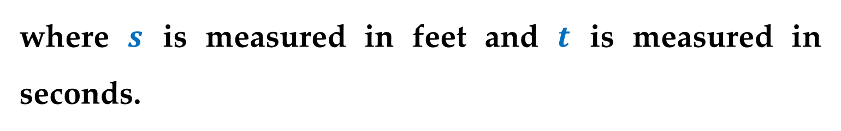
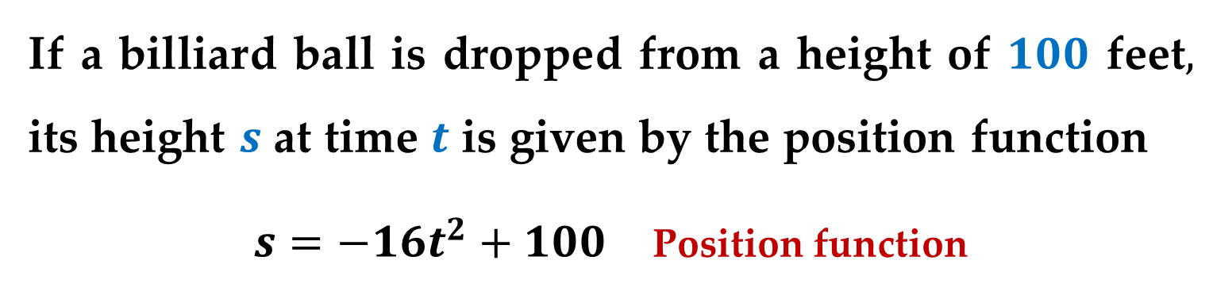
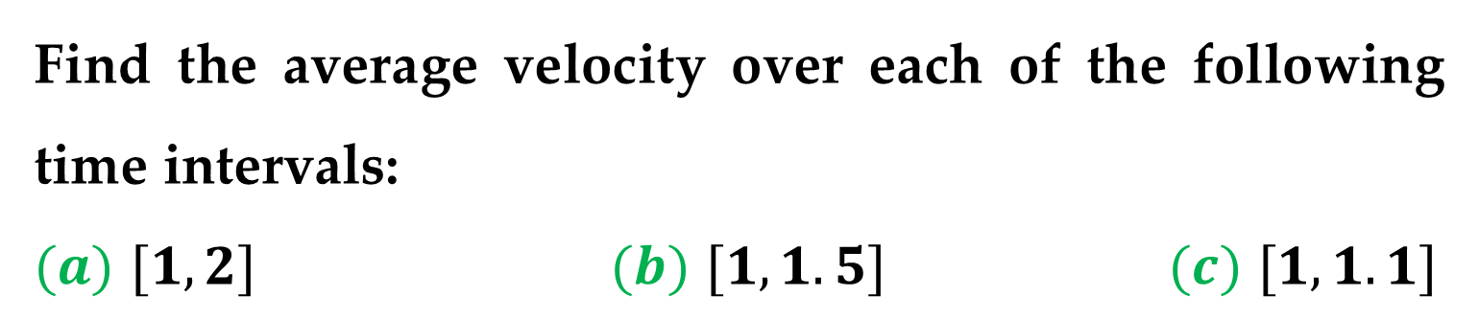
Example 9. Finding Average Velocity of a
Falling Object
If a billiard ball is dropped from a height of $100$ feet$,$ its height $s$ at time $t$ is given by the position function
$s=−16t^{2}+100$ Position function
where $s$ is measured in feet and $t$ is measured in seconds.
Find the average velocity over each of the following time intervals:
$(a)$ $[1,2]$ $(b)$ $[1,1.5]$ $(c)$ $[1,1.1]$

Slide 31
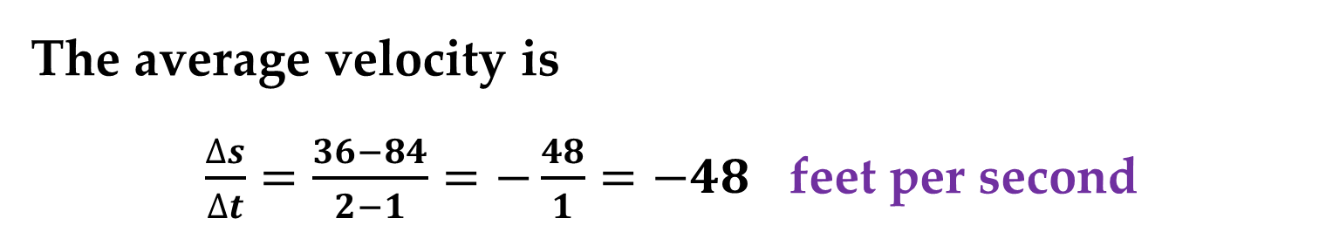
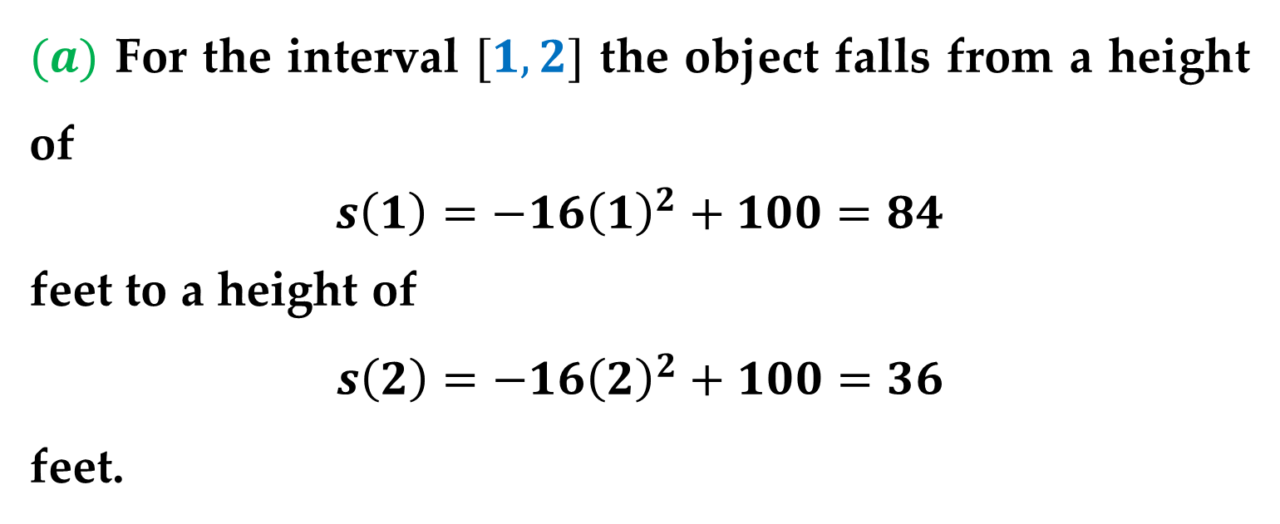
Solution
$(a)$ For the interval $[1,2]$ the object falls from a height of
$s\left(1\right)=−16{\left(1\right)}^{2}+100=84$
feet to a height of
$$s\left(2\right)=−16{\left(2\right)}^{2}+100=36$$
feet.
The average velocity is
$\frac{∆s}{∆t}=\frac{36−84}{2−1}=−\frac{48}{1}=−48$ feet per second

Slide 32
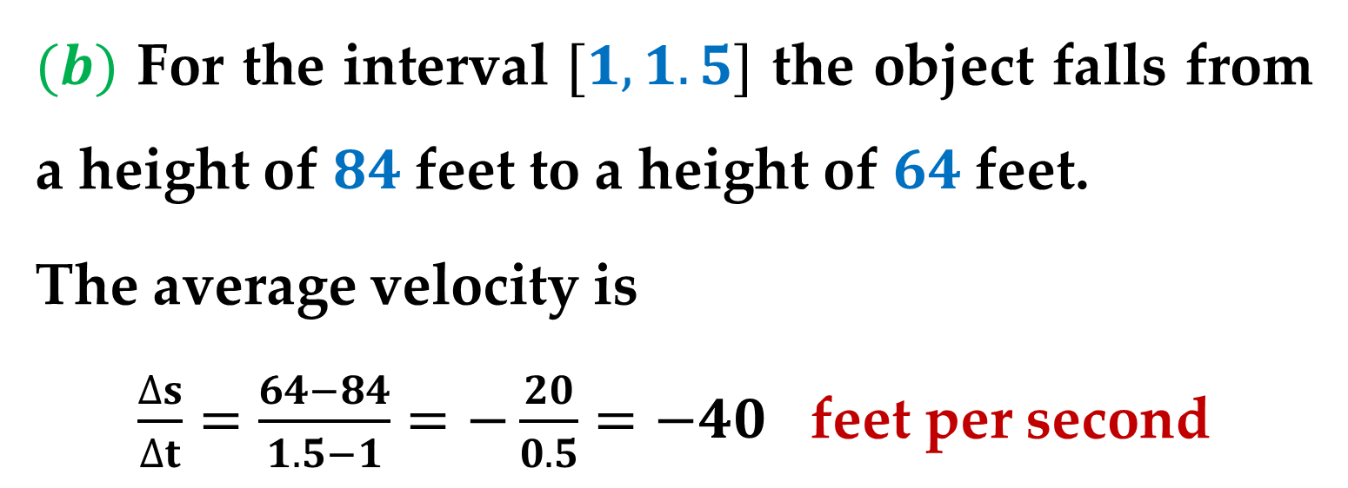
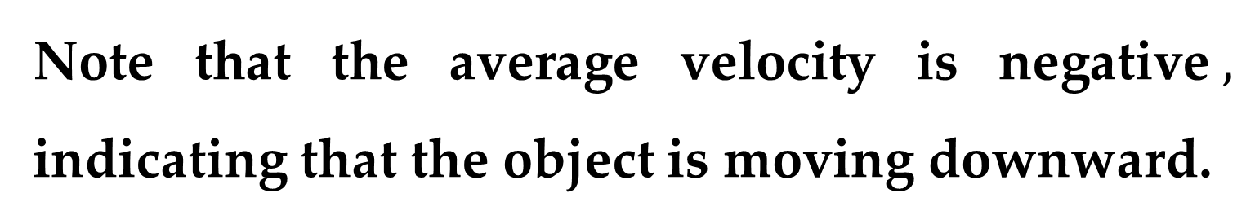
Solution (continued)
Note that the average velocity is negative$,$ indicating that the object is moving downward.
$(b)$ For the interval $[1,1.5]$ the object falls from a height of $84$feet to a height of $64$feet.
The average velocity is
$\frac{∆s}{∆t}=\frac{64−84}{1.5−1}=−\frac{20}{0.5}=−40$ feet per second

Slide 33
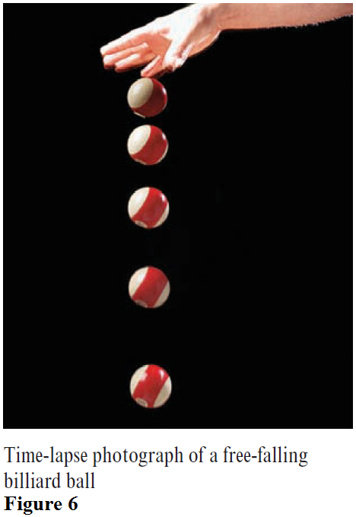
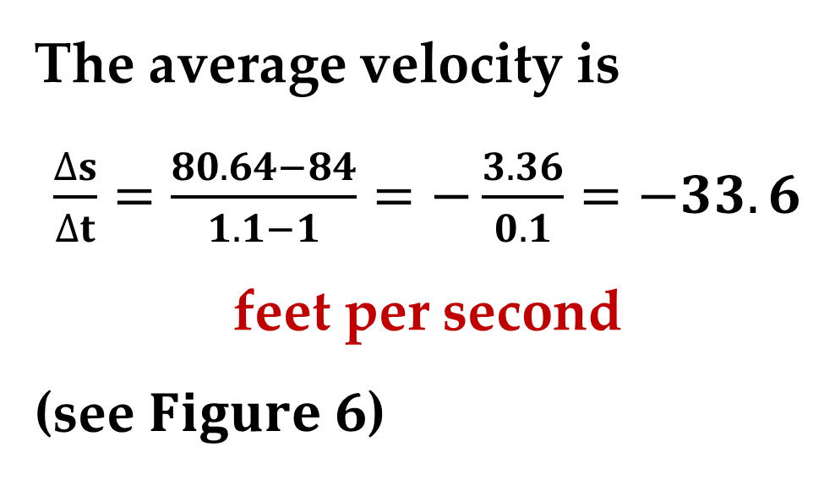
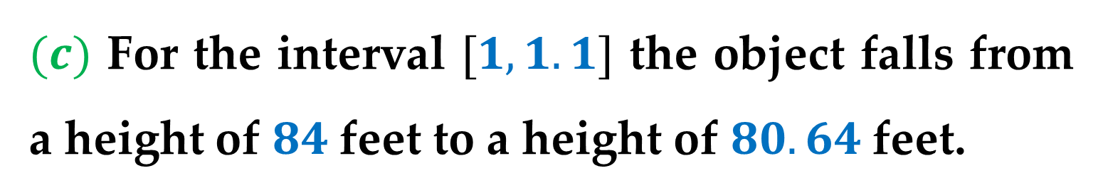
Solution (continued)
$(c)$ For the interval $[1,1.1]$ the object falls from a height of $84$feet to a height of $80.64$feet.
The average velocity is
$\frac{∆s}{∆t}=\frac{80.64−84}{1.1−1}=−\frac{3.36}{0.1}=−33.6$
feet per second
(see $Figure 6$)

Slide 34


Example 9. (modified)
Suppose that you wanted to find the instantaneous velocity of the object when $t=1$.
Just as you can approximate the slope of the tangent line by calculating the slope of the secant line, you can approximate the instantaneous velocity at $t=1$ by calculating the average velocity over a small interval
$$[1,1+∆t]$$

Slide 35


Solution
By taking the limit as $∆t$ approaches zero$,$ you obtain the velocity when
$t=1$
(see $Figure 7$).

Slide 36


In general$,$ if $s=s(t)$ is the position function for an object moving along a straight line$,$ the velocity of the object at time $t$ is
$v\left(t\right)=\lim_{∆t→0}{\frac{s\left(t+∆t\right)−s(t)}{∆t}=s′(t)}$ velocity function
In other words$,$ the velocity function is the derivative of the position function. (velocity can be negative$,$ zero$,$ or positive)
The speed of an object is the absolute value of its velocity. (speed cannot be negative)

Slide 37



The position of a free-falling object (neglecting air resistance) under the influence of gravity can be represented by the equation
$s\left(t\right)=\frac{1}{2}gt^{2}+v_{0}t+s_{0}$ Position function
where $s_{0}$ is the initial height of the object$,$ $v_{0}$ is the initial velocity of the object$,$ and $g$ is the acceleration due to gravity.
On Earth$,$ the value of $g$ is approximately $−32$ feet per second per second or $−9.8$ meters per second².

Slide 38



Example 10. Using the Derivative to Find Velocity
At time $t=0$ a diver jumps from a platform diving board that is $32$ feet above the water (see $Figure 8$).
The position of the diver is given by
$$s\left(t\right)=−16t^{2}+16t+32$$
where $s$ is measured in feet and $t$ is measured in seconds.

Slide 39


Example 10. (continued)
$(a)$ When does the diver hit the water?
$(b)$ What is the diver$’$s velocity at impact?
Solution
$(a)$ To find the time when the diver hits the water$,$ let $s=0$ and solve for $t$:
$$−16t^{2}+16t+32=0$$
$$−16\left(t+1\right)\left(t−2\right)=0$$
$$t=−1 or 2$$

Slide 40


Solution (continued)
Because $t≥0$, choose the positive value to conclude that the diver hits the water at $t=2$ seconds.
$(b)$ The velocity at time $t$ is given by the derivative
$s^{′}\left(t\right)=−32t+16$
So$,$ the velocity at time $t=2$ is
$s^{′}\left(2\right)=−32\left(2\right)+16=−48$ feet per second

Slide 41
Thank you for attention

